Slide 1

Named Entity Recognition on Medical Journals

Slide 2
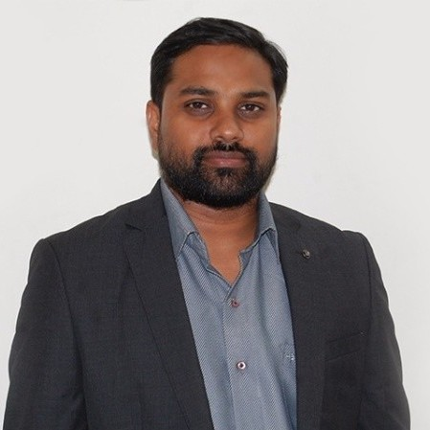
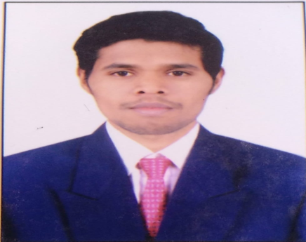
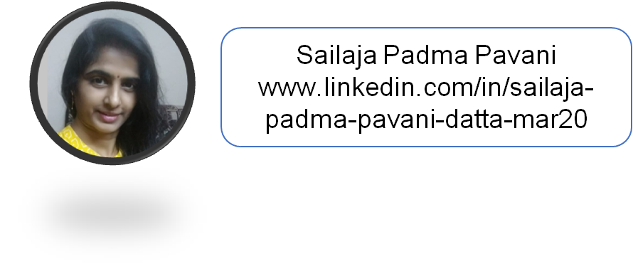
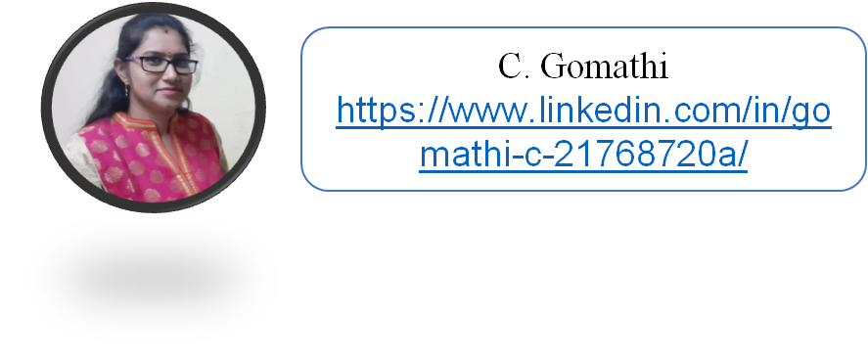
Project Leadership
Raju G
PROJECT MANAGER linkedin.com/in/raju-gulla-728770217/
Sharat Manikonda
Director at Innodatatics and Sponsor
linkedin.com/in/sharat-chandra

Slide 3
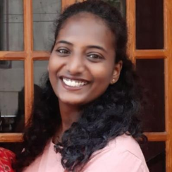
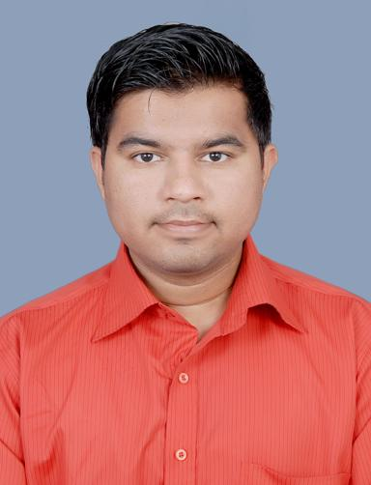
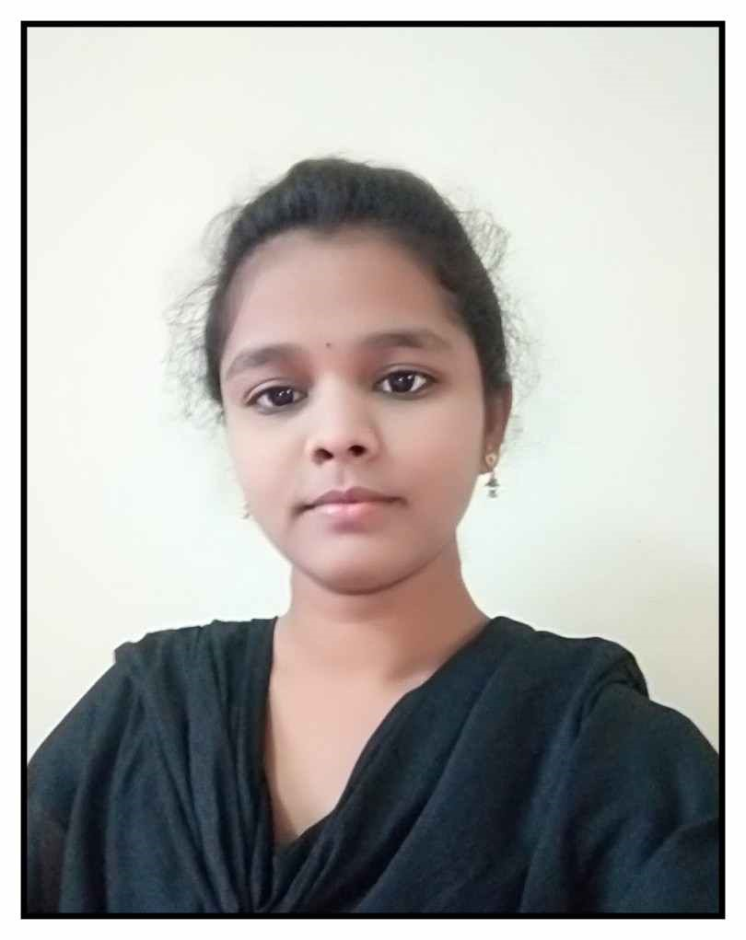
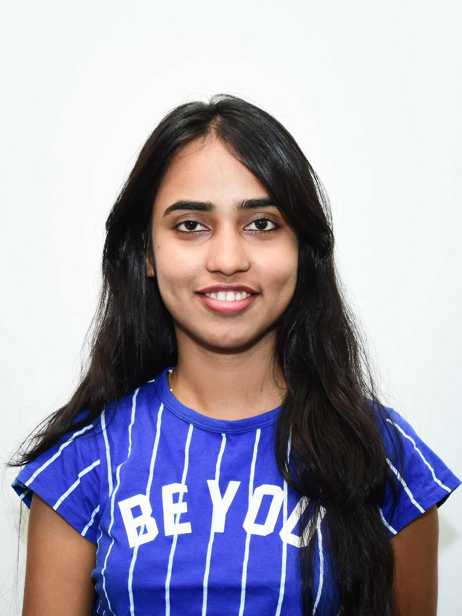
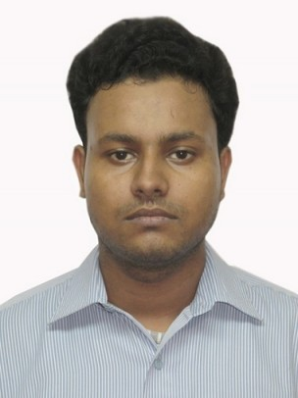

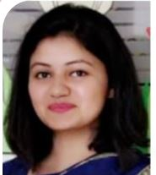
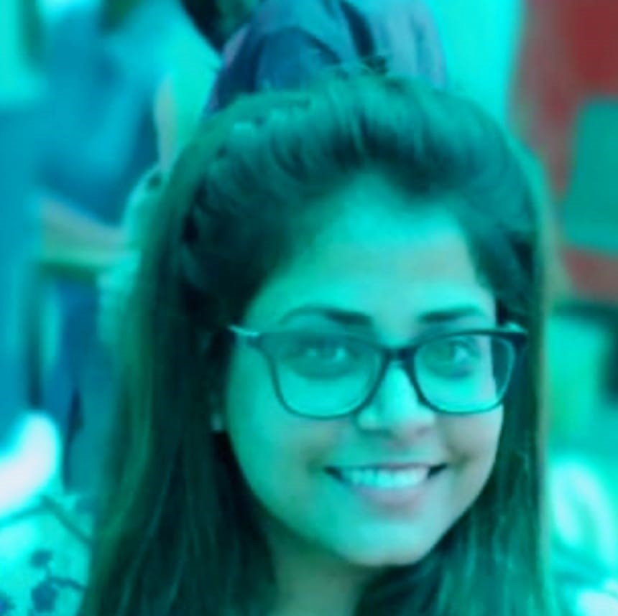
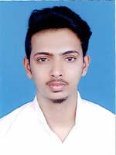
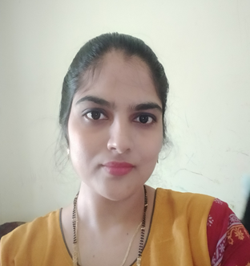
Team Members
A A Ashwini
https://www.linkedin.com/in/a-a-ashwini-45a9221b9
Akshay Avinash Jagtap
https://www.linkedin.com/in/jagtapakshay444
Anchikatti Vijaya
Gowri
https://www.linkedin.com/in/anchikatti-vijaya-gowri-67a973188
Anjum B N
https://www.linkedin.com/in/anjum-b-n-2a6715211
Arindam Maji
https://www.linkedin.com/in/arindam-maji-b2a48b198
Ashish Kumar
https://www.linkedin.com/in/ashish-kumar-32b67918b
Komal Sharma
https://www.linkedin.com/in/komal-sharma-801427104
Mamta Sharma
https://www.linkedin.com/in/mamta-sharma-b91492a0/
Mohammed Jabir
https://www.linkedin.com/in/upjabir
Noorunnisa.k
https://www.linkedin.com/in/noori-shaikh-098803200

Slide 4
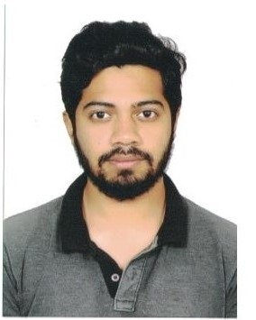
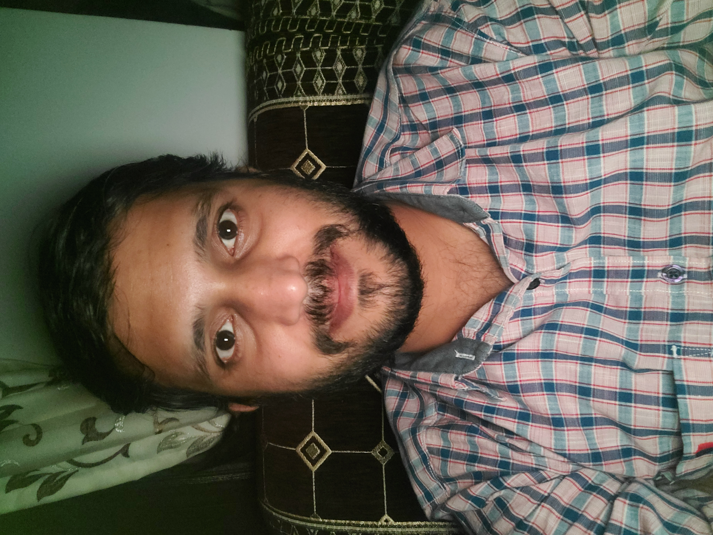
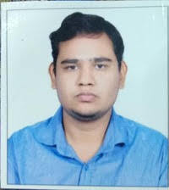
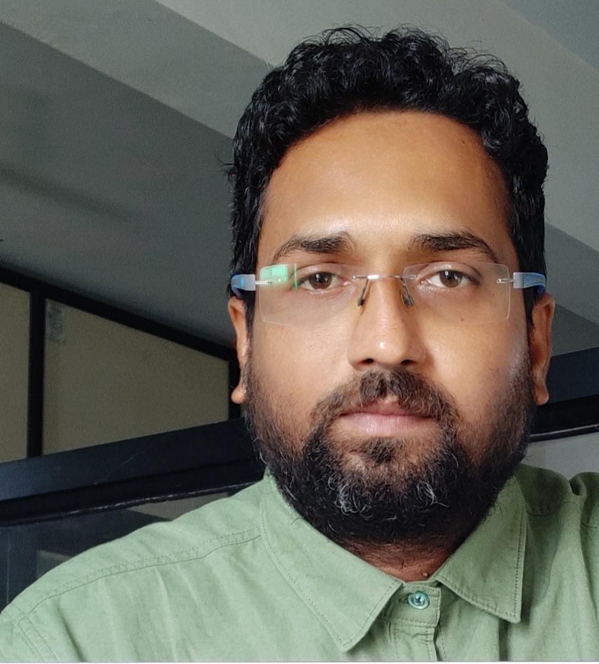
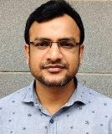

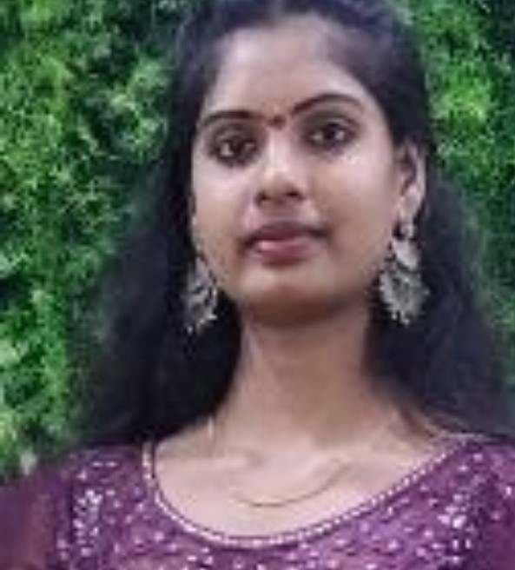
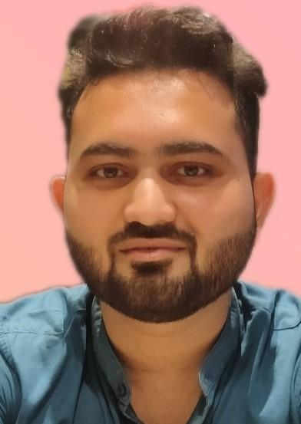

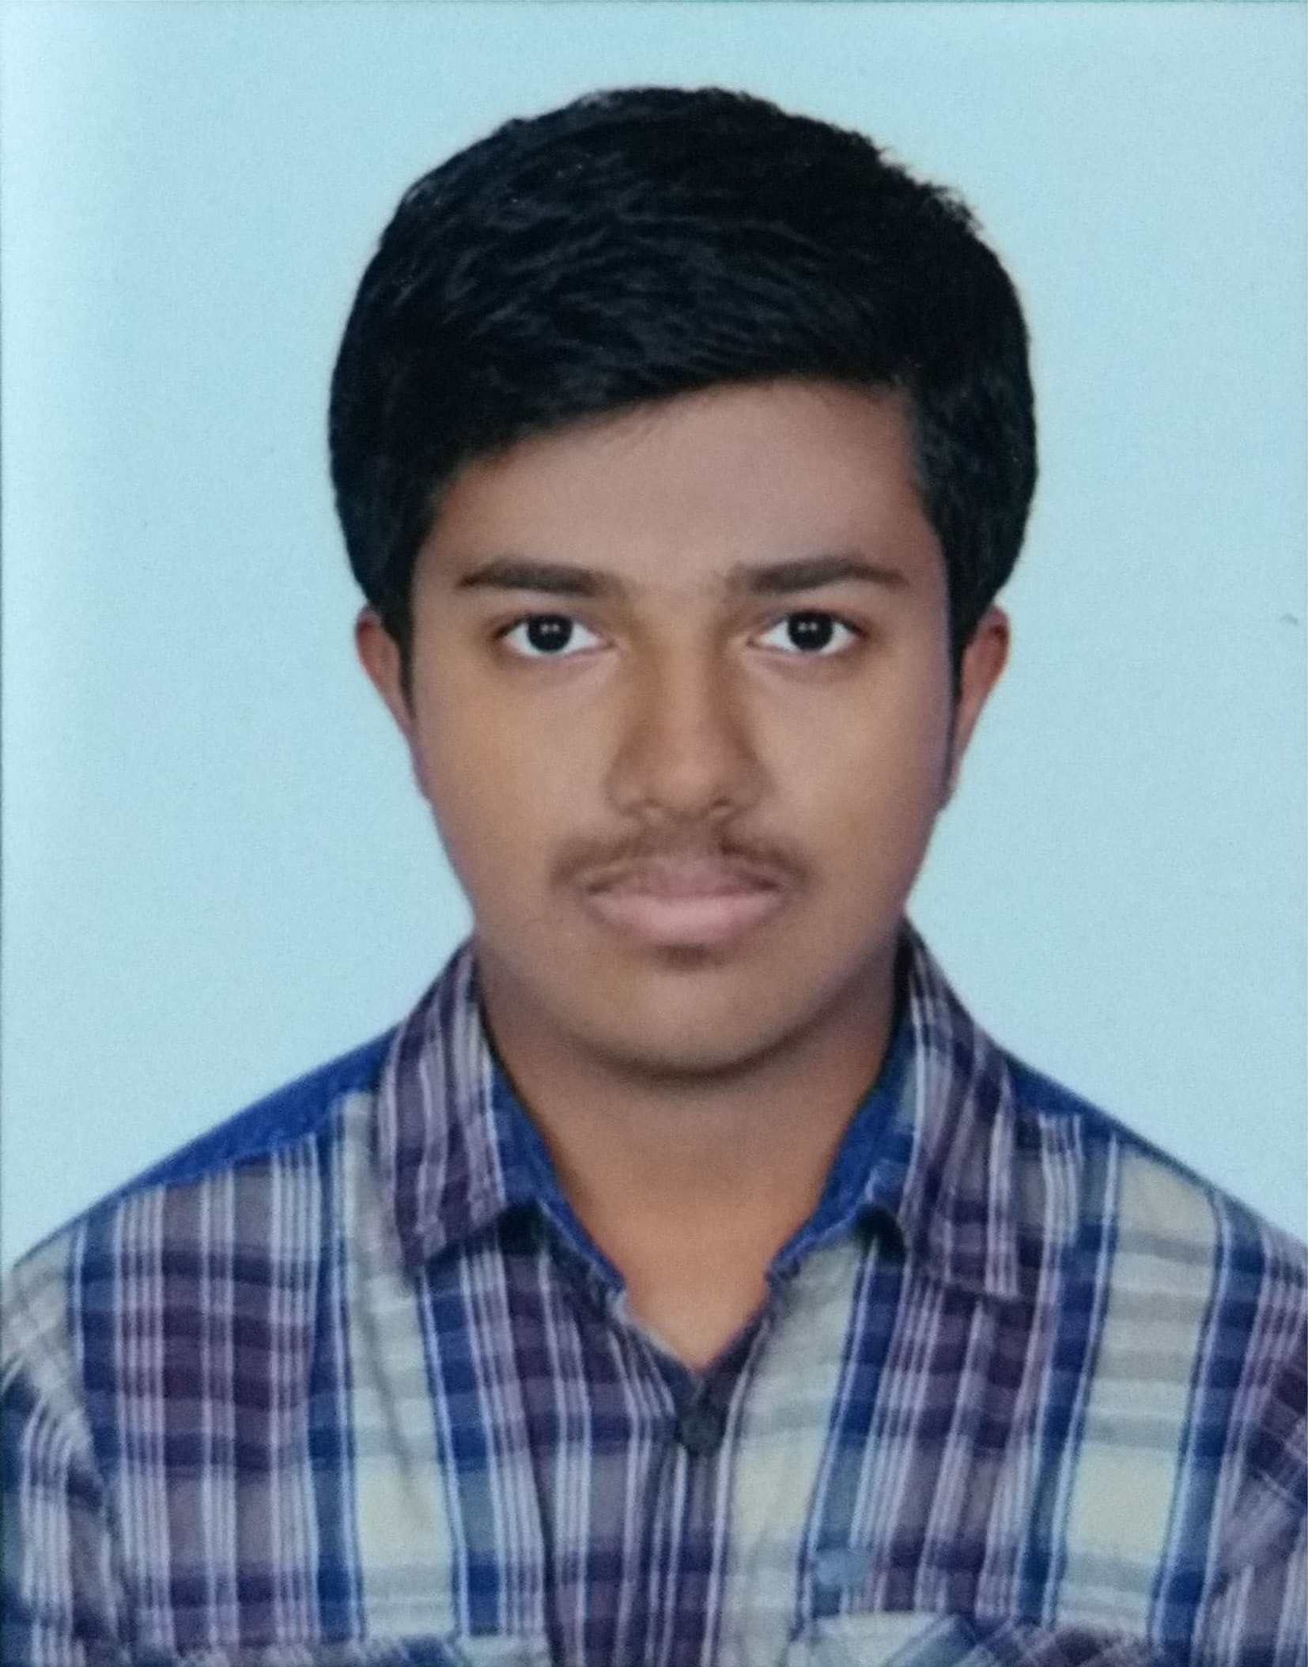
Team Members
Mohammed Zaid Habibulla
https://www.linkedin.com/in/zaid-habib-814a1a143/
Mrityunjay Pathak
https://www.linkedin.com/in/mrityunjay-pathak-4122aa24
Panchanand Jha
https://www.linkedin.com/in/panchanand-jha-7767674b
Pranay Shikar
http://www.linkedin.com/in/pranay-shikari
Rajeshkumar Jha
https://www.linkedin.com/in/rajeshkumar-jha-4772a824
Rishi Kumar
https://www.linkedin.com/in/rishi-verma-1993oct
Giragani Pallavi
https://www.linkedin.com/in/giragani-pallavi-0bb02a20a/
Rituraj Kumar
https://www.linkedin.com/in/rituraj-kumar-19b03521b/
Sagar Lalwani
https://www.linkedin.com/in/sagar-lalwani-85452521a/
Sai Rahul Nagulakonda
https://www.linkedin.com/in/sairahuln

Slide 5
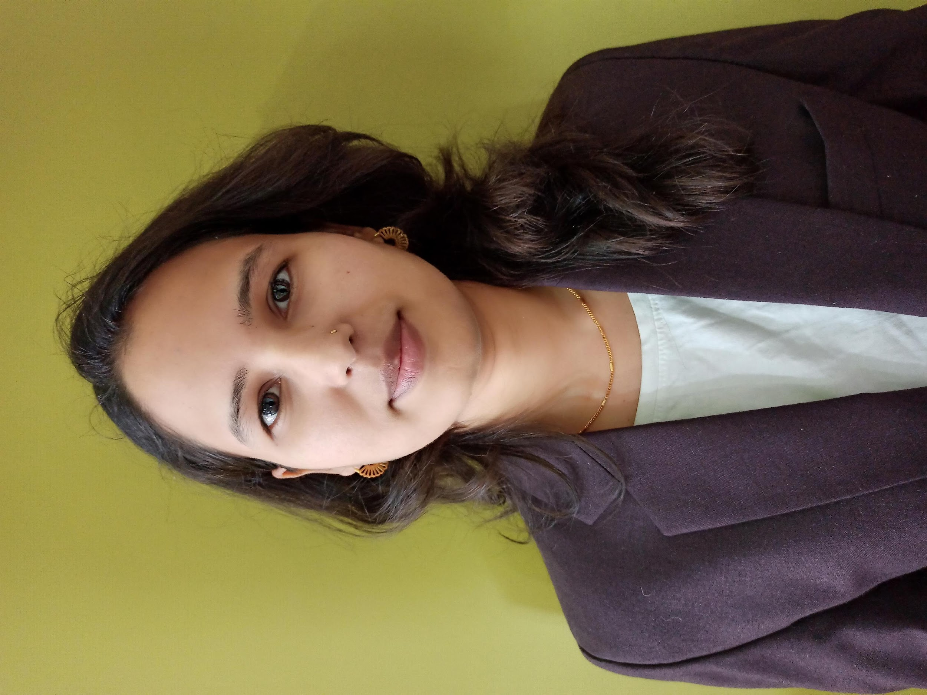

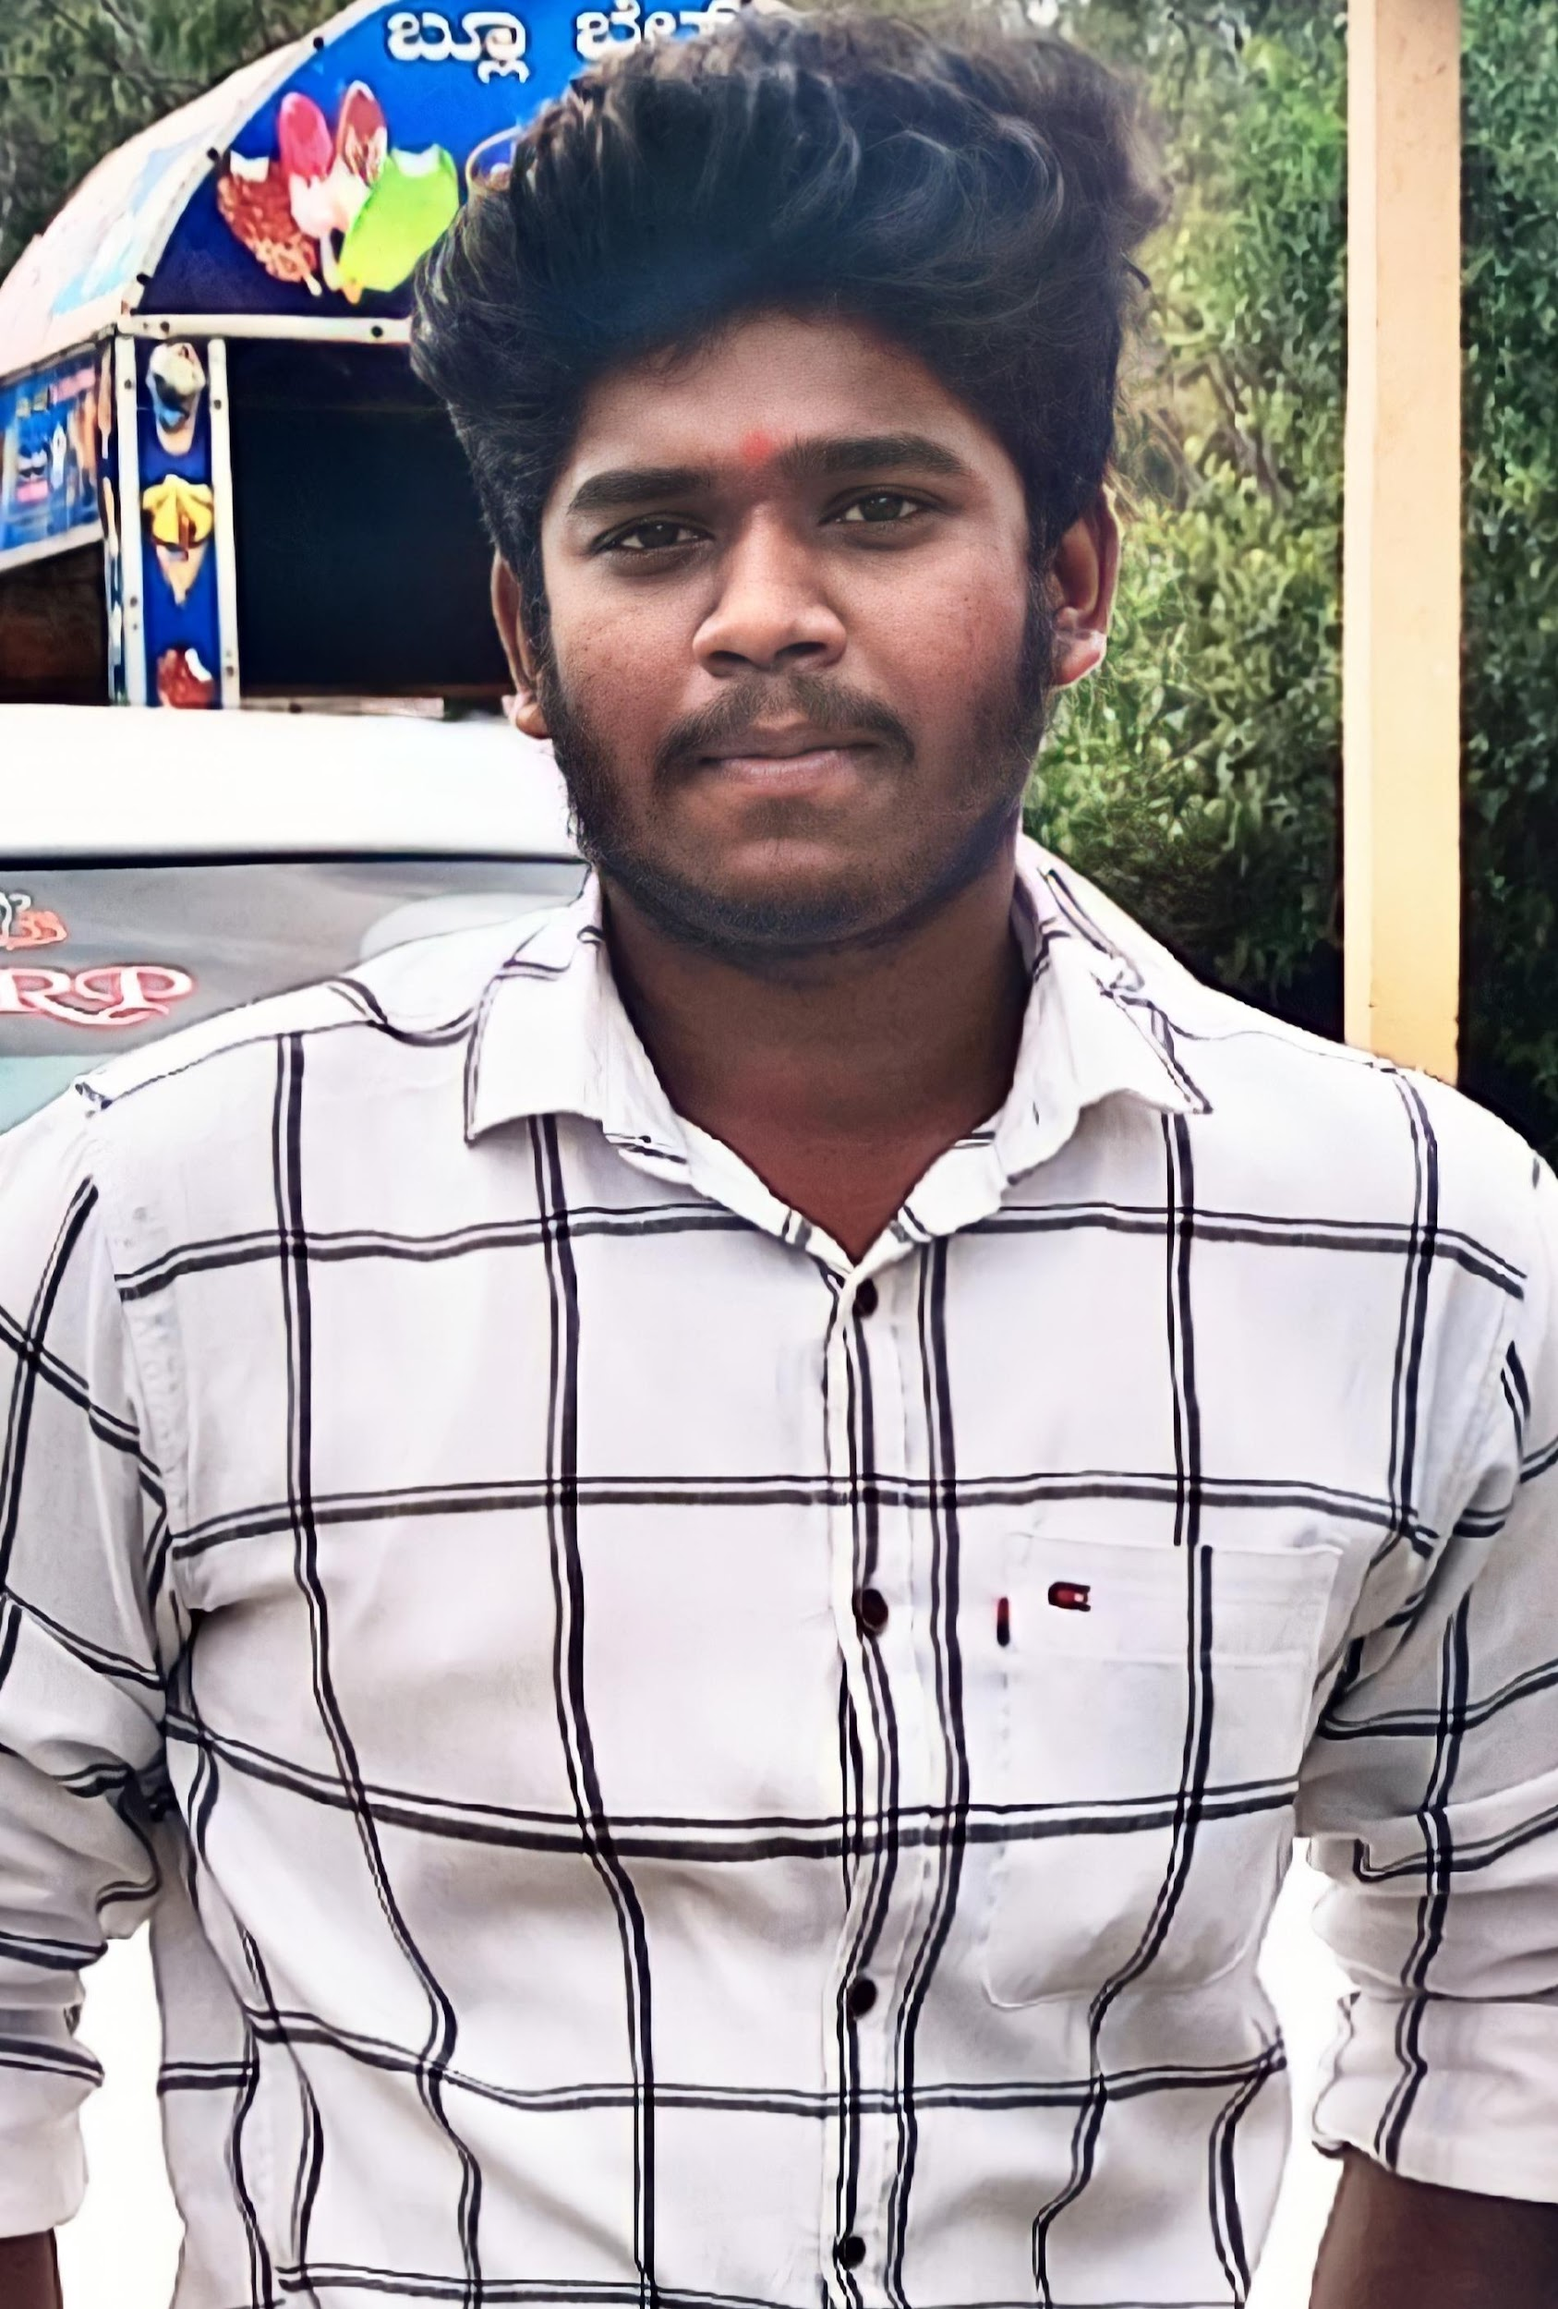

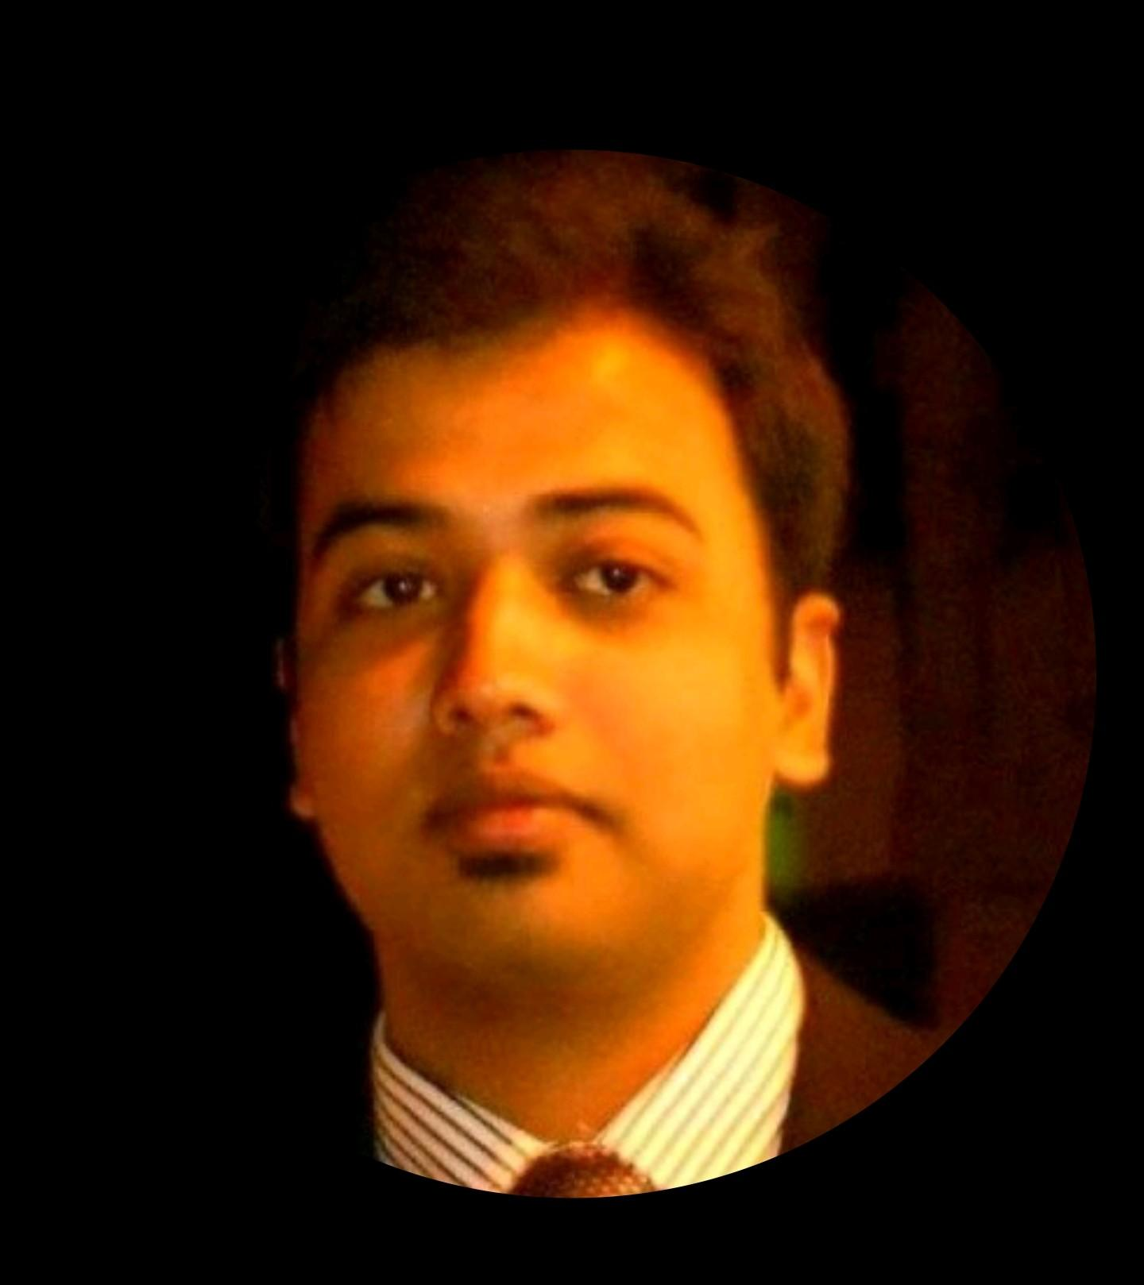


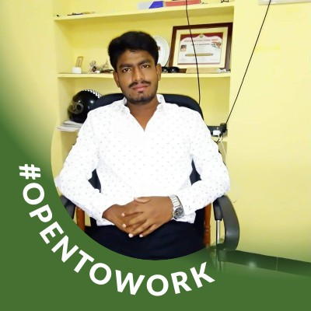

Team Members
Vijai V
https://www.linkedin.com/in/mamta-sharma-b91492a0/
Vijay krishna https://www.linkedin.com/in/vijay-krishna-a249171a5
Ashpak Sheikh
https://www.linkedin.com/in/ashpak-sheikh-235509168/
Rhutuja Kamal Raut
https://www.linkedin.com/in/rhutuja-raut-7766221a4
Dhruba Chakrabarty
https://www.linkedin.com/in/dhrubachakrabarty
Emmanuel Mitra
https://www.linkedin.com/in/emmanuel-mitra-0a13b2216
Dheeraj Kumar Mishra
https://www.linkedin.com/in/dheeraj-kumar-mishra-b4546320b
Ricky Kuttaiah M M
https://www.linkedin.com/in/ricky-kuttaiah-4050a8163
Upadhyay Sachin Naresh
https://www.linkedin.com/in/usachin61/

Slide 6
Contents
Project overview and Scope
Project Goals
CRISP-ML(Q) Methodology
Technical Stacks
Project Architecture
Input to Output
Named Entity Recognition
Data Understanding
Data Preparation
Model Selection and Building
Output
Deployment
Conclusion
Model Evaluation and Fine-tuning
Future Scope

Slide 7
Project Overview and Scope
Extracting valuable information from text manually is a time consuming task for domain experts
This project aims to address that through natural language processing (NLP) to analyse the biomedical literature and extract useful information within much less time
This project is about Information Extraction (IE) i.e., extracting meaningful info such as drug names, diseases, strength, dosage etc from medical journals(pdf) for further use by different end users
We are building this tool to minimize time and manpower & provide as accurate and thorough results as possible

Slide 8
Project Goals
Objectives
Constraints
Business Problem: To extract maximum number of named entities from the medical journals
Maximize - The accuracy of the extracted entities
Minimize - The error in selecting the named entity and time required
Recognizing the medical terms accurately is a difficult task
Recognizing more number of medical terms is a bit difficult task

Slide 9
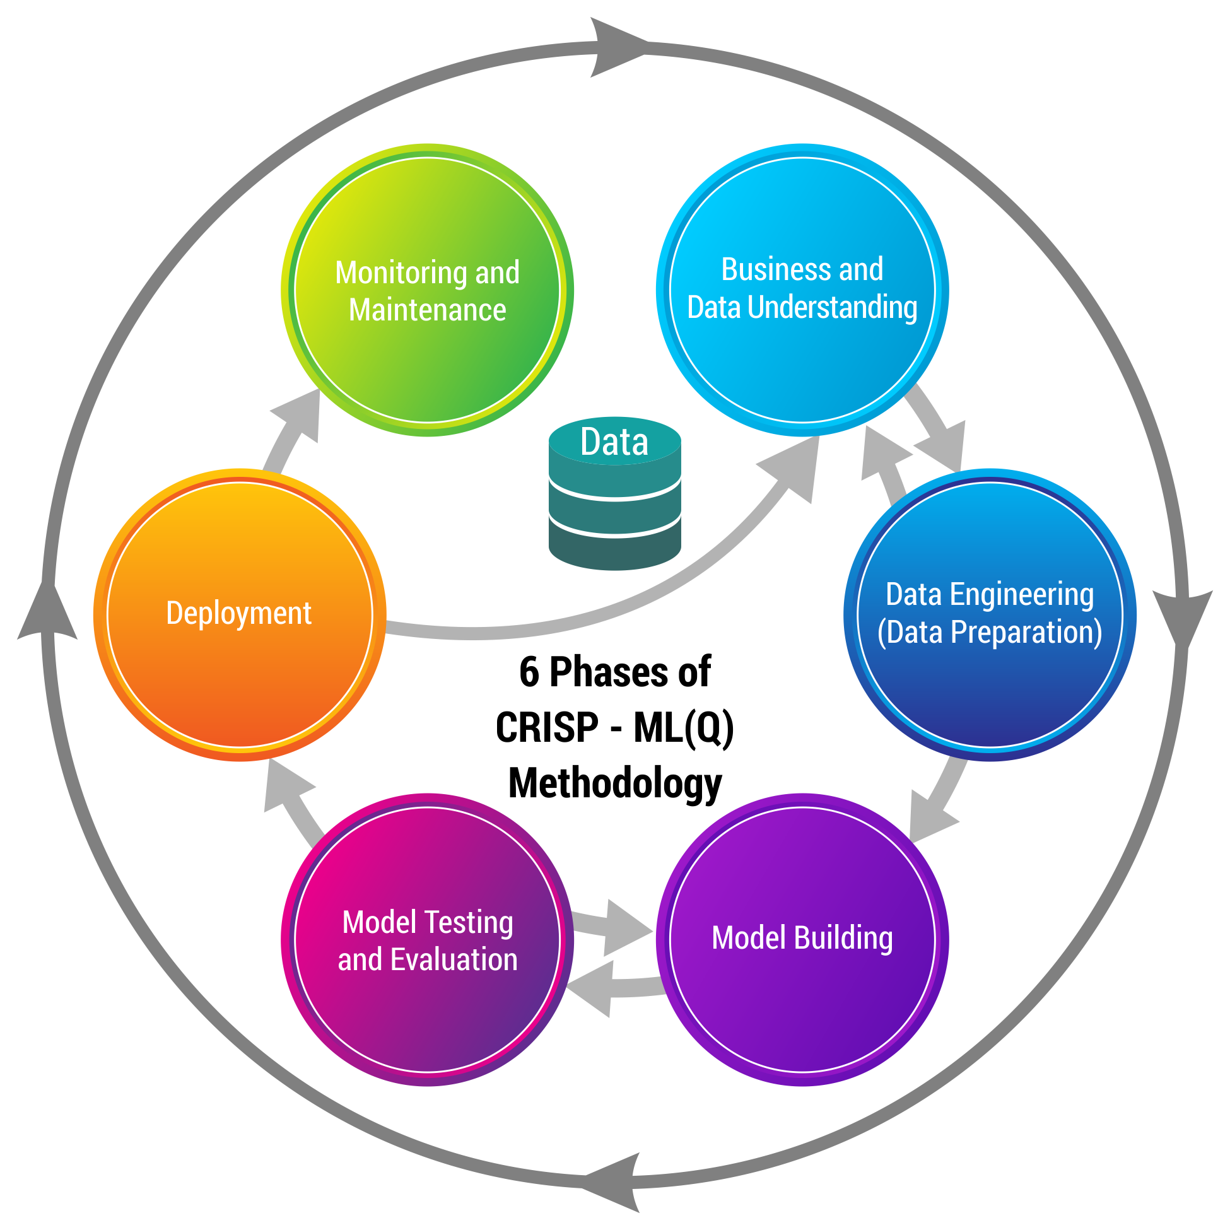
CRISP-ML(Q) Methodology

Slide 10




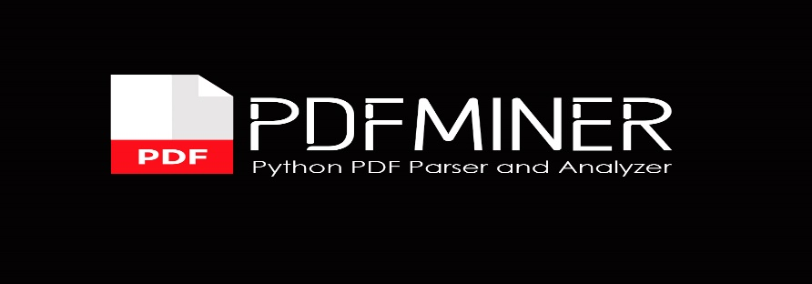
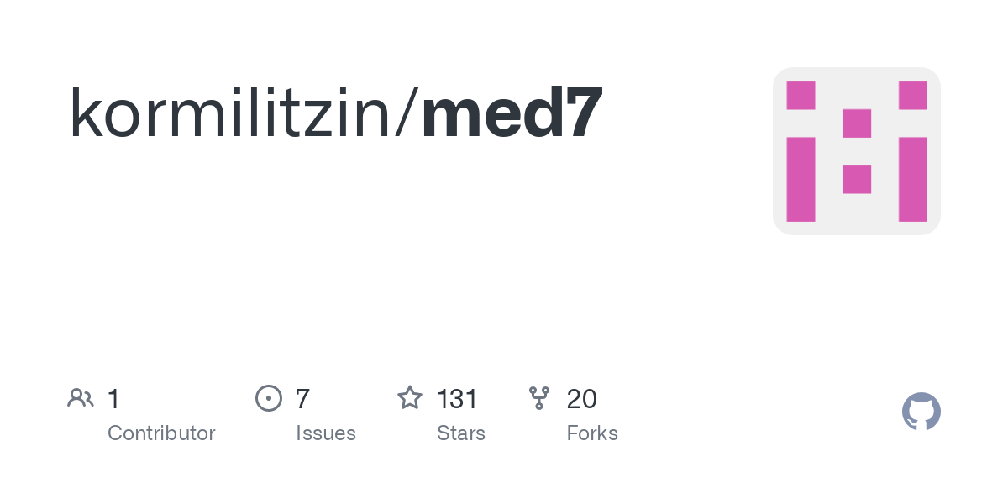

Technical Stacks
These are some tools and software Environment
we used for our project:
Python: We used for EDA and Model Building
Python IDE: Jupyter Notebook and Google colab
Pdfminer: is a python package for extracting information from PDF documents
NLTK: is a toolkit build for working with NLP in Python. It provides us various text processing libraries with a lot of test datasets
Med7: a transferable clinical natural language processing model for electronic health records
Spacy: is an open-source software python library used in advanced natural language processing and machine learning

Slide 11

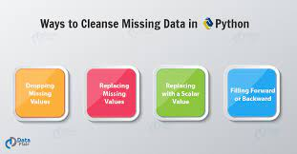
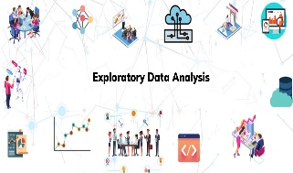


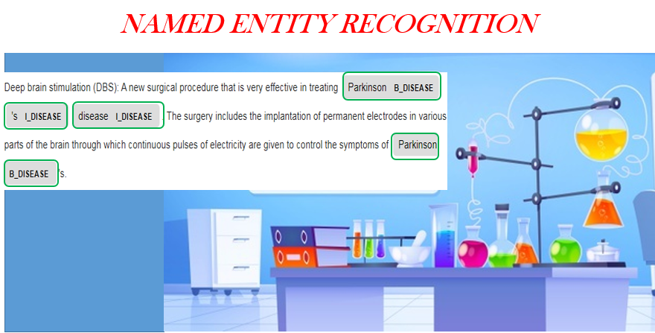

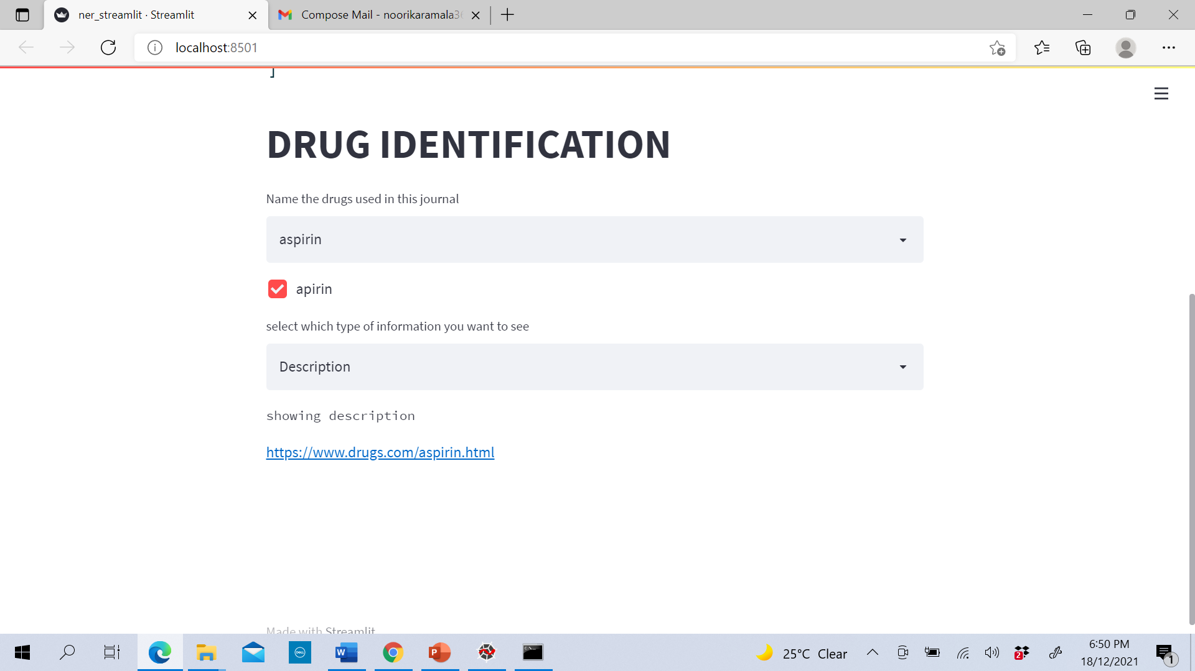
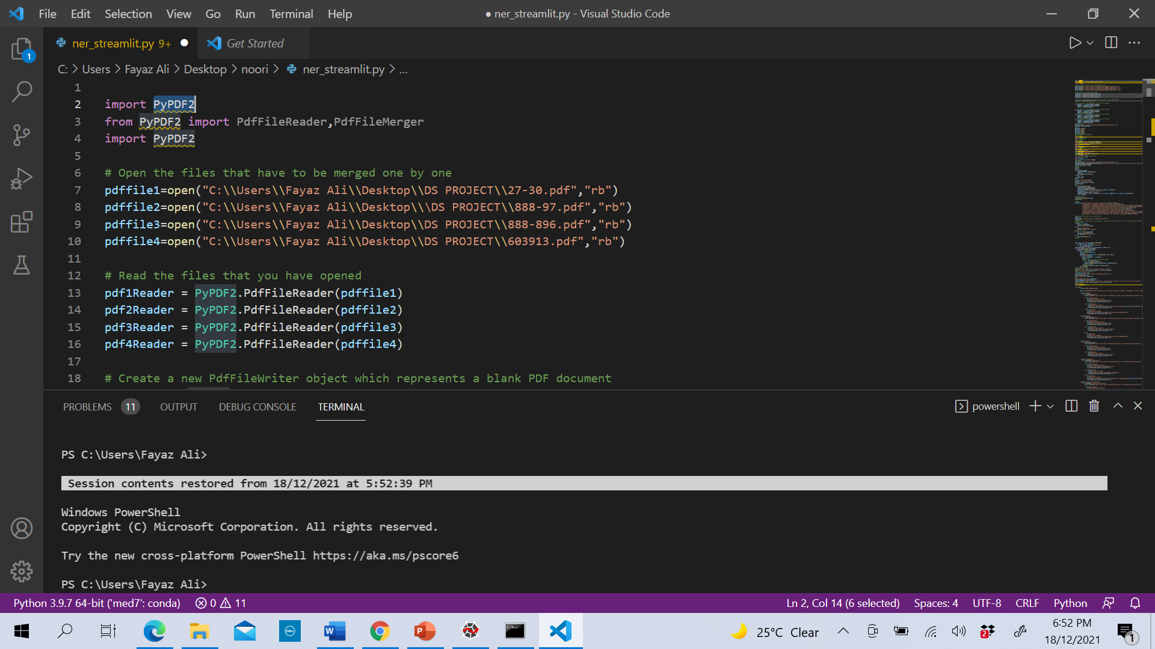


Project Architecture
Data collection
Data Preparation
Model Evaluation
Model Building
Model Deployment
Upload Entities to Database

Slide 12
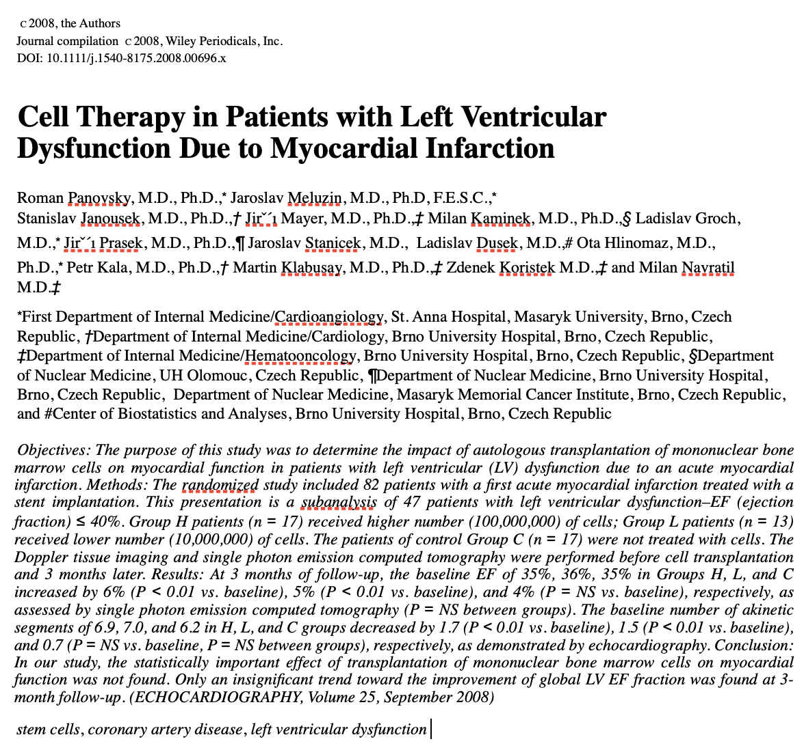


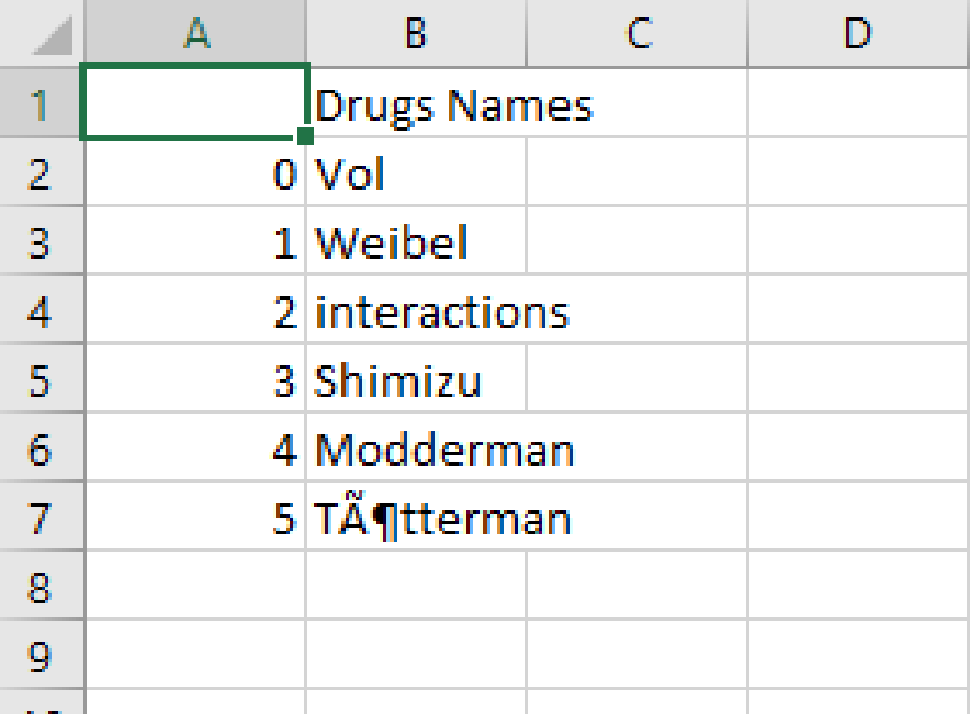
Input to Output
Model

Slide 13
NER for Medical Journals
Named Entity Recognition
As per Wikipedia, a named entity is a real world object such as persons, locations, organizations, products, etc. that can be denoted with a proper name and NER is a part of information extraction where the goal is to locate and classify such named entities
In healthcare, named entity recognition models are essential for identifying and extracting entities like diseases, tests, treatments and test results from medical texts/records
A challenge in disease NER is disease names are usually generated by combining Greek and Latin roots and affixes Eg: hemo-chromatosis

Slide 14

Data Understanding
The data required to train is given in the form of pdf/word doc(unstructured)
Information contains entities such as Symptoms, Diseases, Drug names, Strength and Dosage, Person name, Institute name, etc.
The focus of the project is to extract these entities
This can be done through NLP(NER) by using NLTK or SPACY library

Slide 15

Data Preparation
Basic text cleaning and preprocessing steps were taken to standardize the text
Additionally, standard escape sequences(‘\t’, ’\n’ and ’\r’) were also removed and the offsets of the gold-annotated entities were adjusted accordingly
And additional steps for data preparation
Lemmatization
Word Cloud

Slide 16
Model Description
Libraries Used:
Numpy
Pandas
Spacy
En-core-med7-lg
Description:
Numpy is a library for the Python programming language, adding support for large, multi-dimensional arrays and matrices, along with a large collection of high-level mathematical functions to operate on these arrays
Pandas is used to read/manipulate dataframe
Spacy is used to build NLP model to extract features
En-core-med7-lg is used to extract specifically medical entities such as drug , frequency etc.

Slide 17
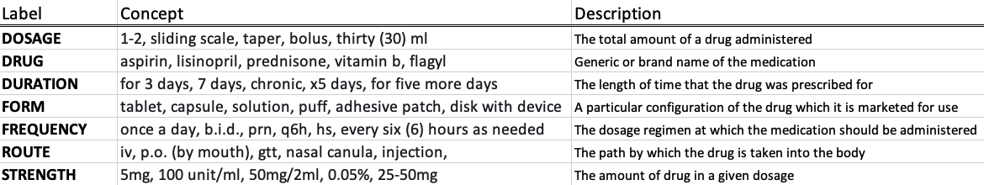
Med7
Med7 is a transferable clinical natural language processing model for electronic health records, compatible with spaCy, for clinical named entity recognition tasks. The en_core_med7_lg model is trained on MIMIC-III free text electronic health records and is able to recognize 7 categories as shown below:
The trained model comprises three components in its pipeline:
1. Tagger
2. Parser
3. Clinical NER with seven categories

Slide 18
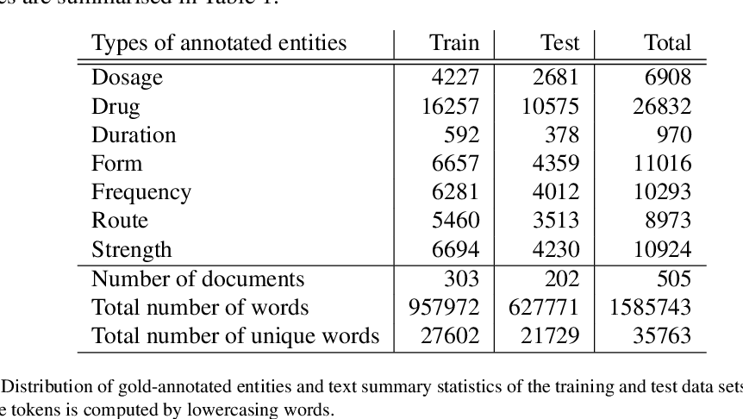
Data used to train Med7 model
MIMIC-III electronic health records database
Track 2 of the 2018 National NLP Clinical Challenges(n2c2) Shared task on drug related concepts extraction, including adverse drug events and reason for prescription
The data set comprised a collection of discharge letters from the ICU and contained very rich and detailed information about medications used for treatment
Also other documents from UK-CRIS platform and NHS were used to train the model
Distribution of drug-annotated entities and text summary statistics of the training and test data sets is computed by lowercasing words

Slide 19
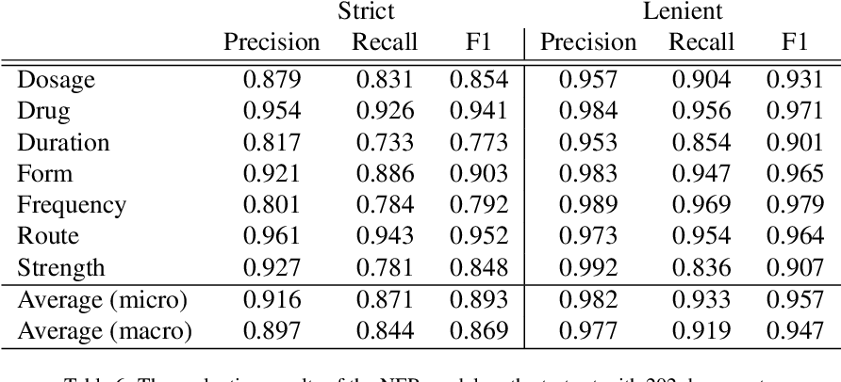
Results of Med7 model
Table: Performance metrics of med7 model

Slide 20
Model Deployment
Database Used:
MySQL
Description:
Output from Model will return a csv file containing entities like drugs, frequency and route as columns
Data from csv file is uploaded into database
User can decide which all entities they need
Based on this query, data from database is displayed

Slide 21
Model Deployment continued…
Framework Used
Streamlit
Description
Streamlit is an open-source Python library that makes it easy to create and share beautiful, custom web apps for machine learning and data science
It takes inputs such as user given text and by uploading file
Uploaded file and text will be provided as Input for Med7 model and Model will recognize the entities
User can also provide which entity is required

Slide 22
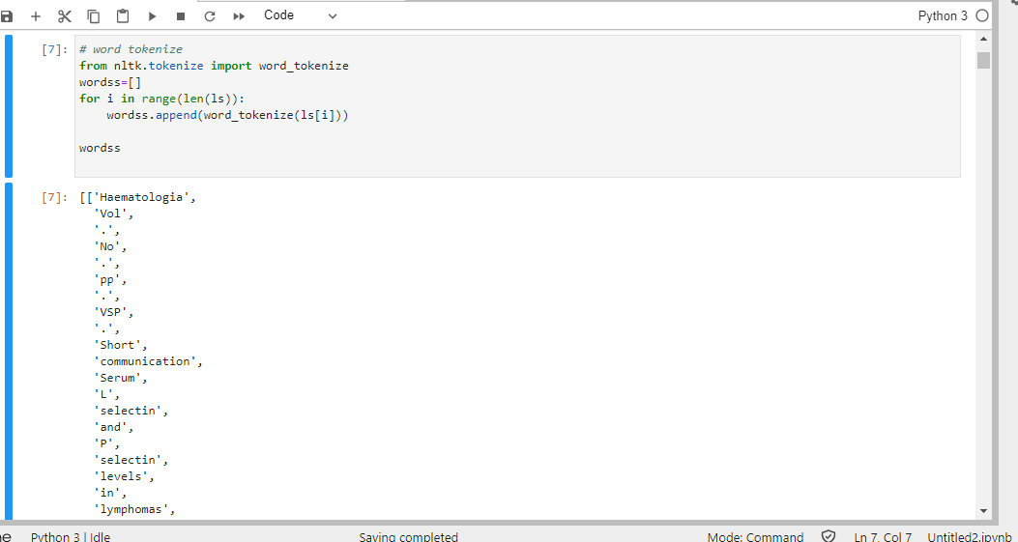
Word Tokenization
Word Tokenization is the process of splitting a large sample of text into words

Slide 23
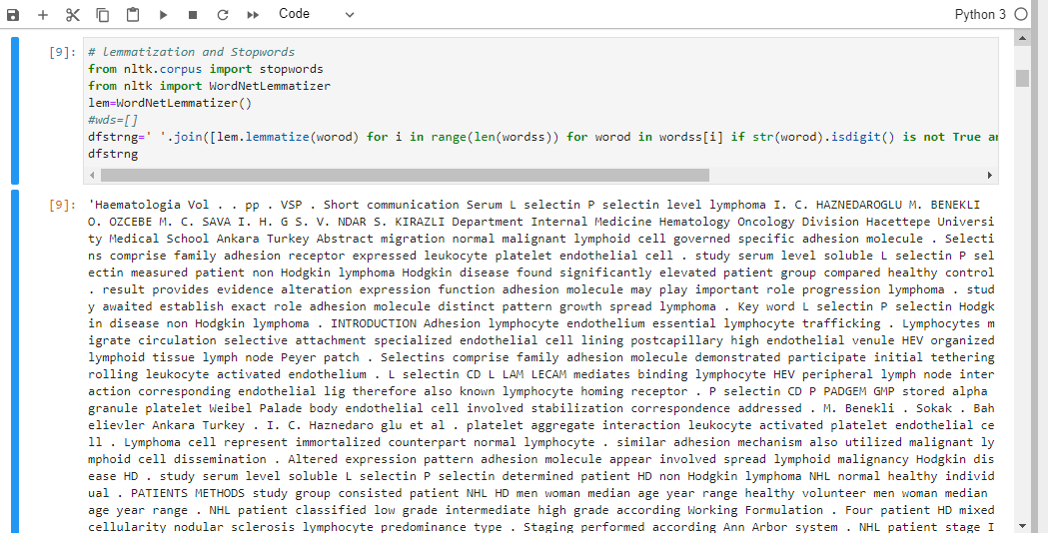
Lemmatization
Lemmatization is the process of grouping together the inflected forms of a word so they can be analyzed as a single item. It gives us meaningful words as output

Slide 24
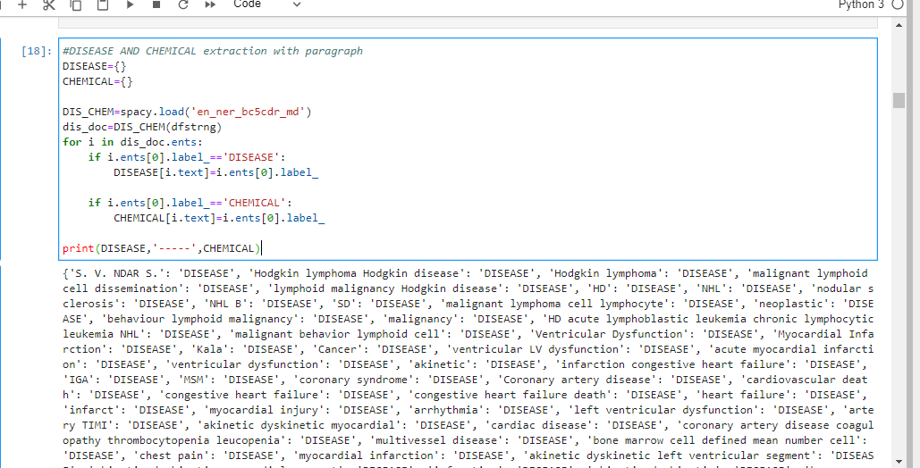
En_ner_bc5cdr_md model
En_ner_bc5cdr_md extracts chemicals and diseases

Slide 25
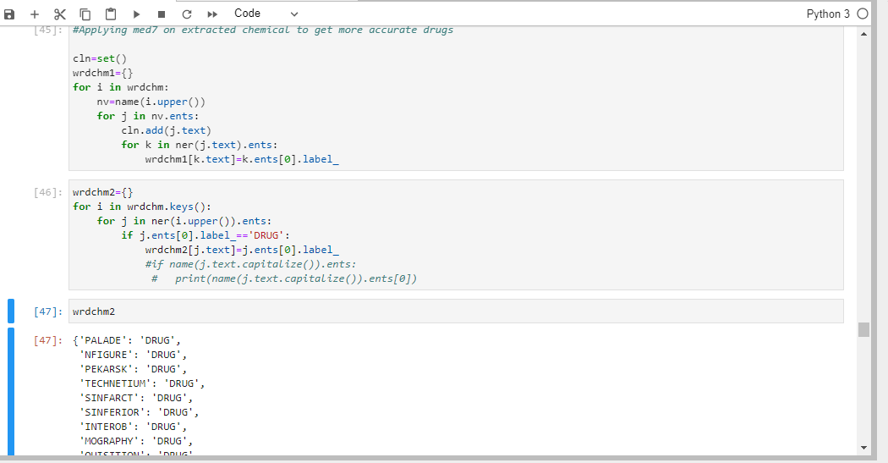
Med7 model on data
Applied Med7 on En_ner_bc5cdr_md results to get more accurate drugs

Slide 26
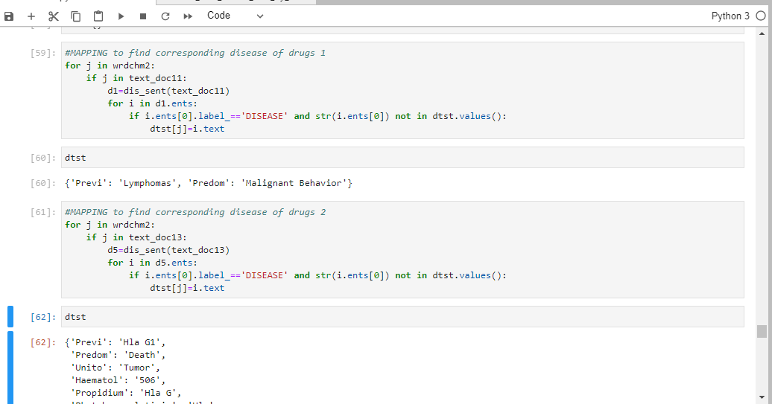
Mapping using Drugbank
Here using web scraping we’ve scrapped almost 10 lakh drugs and disease from drugbank website and mapped extracted drugs with scrapped drugs to get their corresponding diseases

Slide 27
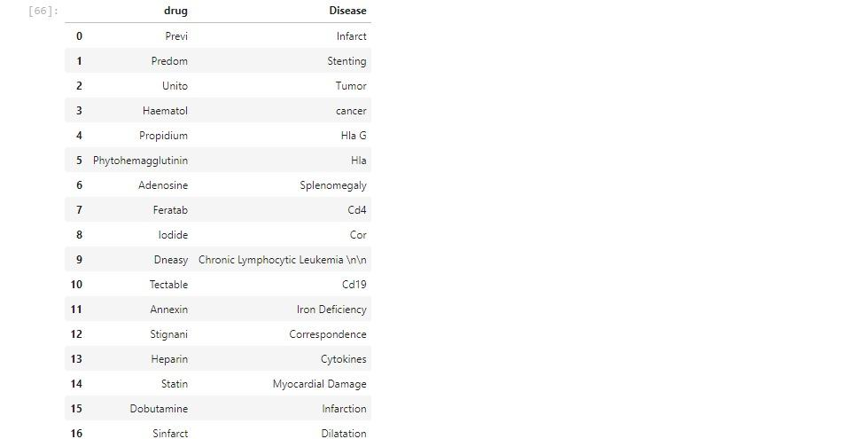
Mapping of drugs and diseases

Slide 28
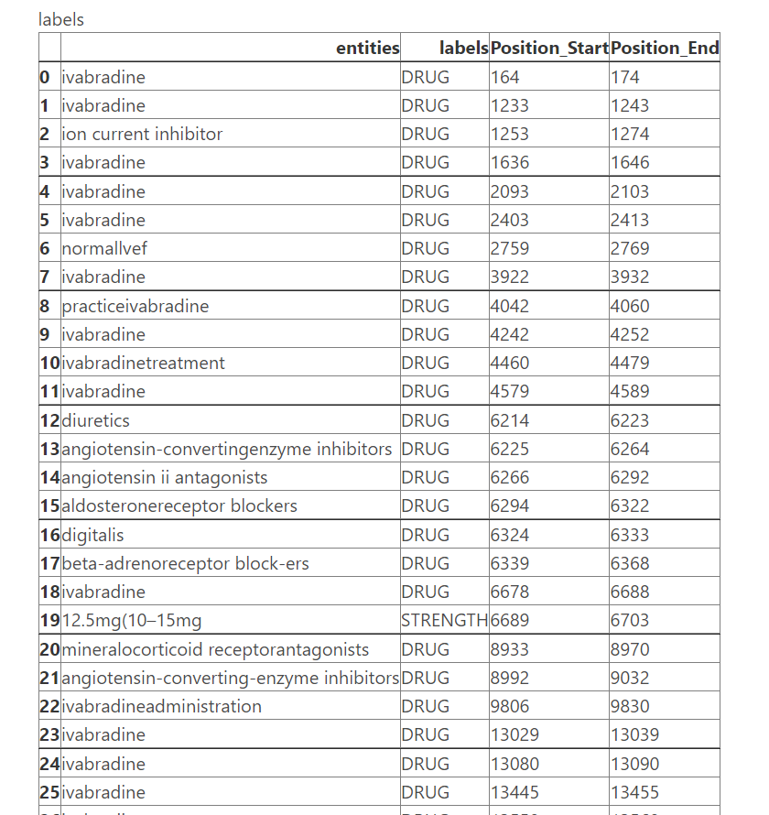
Output
Entities Recognised & extracted by the Model

Slide 29

Deployment Strategy
Streamlit:
Streamlit is an open-source Python library that makes it easy to create and share beautiful, custom web apps for machine learning and data science
Creating Your First Web App in just 4 steps using Streamlit:
The first step is to create a new Python script. Let's call it:
myapp.py
Open myapp.py in your favorite IDE or text editor, then add the below line:
import streamlit as st
Every good app has a title, so let's add one:
st.title(‘My First Web App’)
Now it's time to run Streamlit from the command line:
streamlit run myapp.py

Slide 30
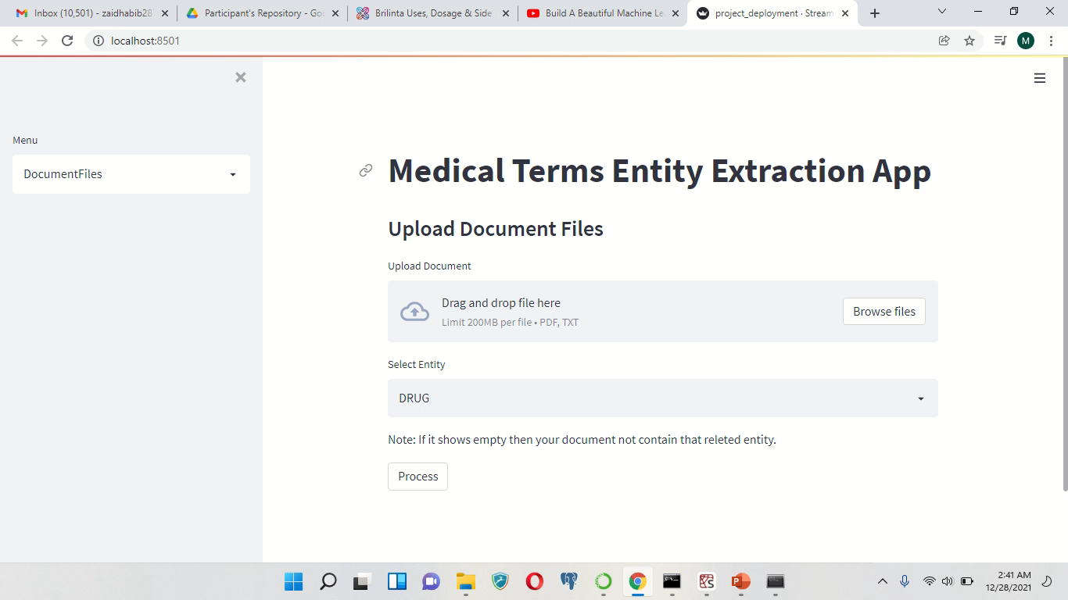
Product Demonstration

Slide 31
Conclusion
Named Entity Recognition model for clinical concepts in unstructured medical records was used to recognize seven categories:
1. Drug names (including both generic and brand names)
2. Dosage of the drugs
3. Form of the Drug
4. Their strength
5. The route of administration
6. Prescription duration
7. Frequency
In detail, it’s a process where algorithm takes a string of text as input and identifies relevant classified entities that are mentioned in that string
The techniques for creating NER system from manual rule-based assignments are providing good and accurate results. But it comes with the time it takes to set the rules like supervised learning which requires a large corpus that needs to be labelled

Slide 32
Model Evaluation and Fine-tuning
Model Evaluation:
To evaluate the accuracy of the features extracted by the model on our data, we need to annotate the documents with the help of domain experts
Fine-tuning the model:
The text cleaning, word tokenization and Lemmatization processes are done to fine-tune the model

Slide 33
Future Scope
Different journals can be used to extract entities and gather information to analyse the information of each entity from different journals
The drugs extracted can be linked to a site that gives more information like the uses, side effects, alternate drugs, etc.
Information gathered from the journals can be used to validate the a new journal of its content
The entities extracted from different journals can be used to find new information about the entities

Slide 34


Slide 35


